Slide 1

UNIT-1
INTRODUCTION TO COMPUTING
PROGRAMMING FOR PROBLEM SOLVING
UNIT-I
Department of CSE, School of Engineering, Malla Reddy University, Hyderabad.
Notes:
You can safely remove this slide. This slide design was provided by SlideModel.com – You can download more templates, shapes and elements for PowerPoint from http://slidemodel.com

Slide 2

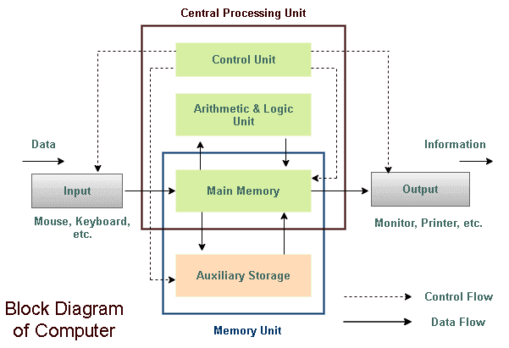
Computer System
“A Computer is an electronic device that stores, manipulates and retrieves the data. We can also refer computer computes the data supplied to it and generates the results.” data.”
01
08
Middle Level
Language
02
Memory
Management
Structured
Language
Speed
03
07
Rich Library
04
Pointers
Extensible
Recursion
05
COMPUTER
PROGRAMMING FOR PROBLEM SOLVING
UNIT-I
Department of CSE, School of Engineering, Malla Reddy University, Hyderabad.

Slide 3
Computer is made up of two major components called
“Hardware” and “Software Components”
Computer Components
Computer
01
08
Middle Level
Language
02
Memory
Management
Structured
Language
03
Speed
Software
Hardware
07
Rich Library
Hardware of a computer system can be referred as anything which we can touch and feel.
Example: CPU,Monitor,Keyboard and Mouse.
Software comprises the entire set of programs, procedures, and routines associated with the operation of a computer system.
Example: OS, C,C++,JAVA,…etc
04
Pointers
Extensible
Recursion
05
PROGRAMMING FOR PROBLEM SOLVING
UNIT-I
Department of CSE, School of Engineering, Malla Reddy University, Hyderabad.

Slide 4
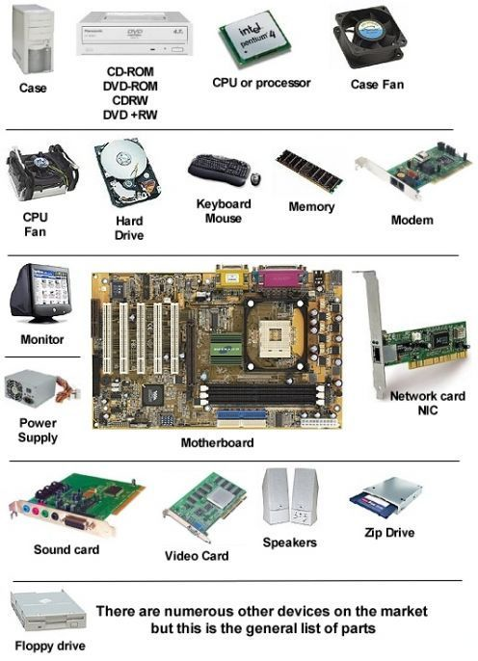
More EXAMPLES OF Computer hardware
All Computer Hardware Components are involved in the functioning of a computer.
All Computer Hardware components can be physically handled.
All these components are divided based on their functionality.
PROGRAMMING FOR PROBLEM SOLVING
UNIT-I
Department of CSE, School of Engineering, Malla Reddy University, Hyderabad.

Slide 5
The hardware parts of a computer system can be mainly classified as Three Types, such as
Hardware
Input (I/P) Devices
(Input Unit)
Output (O/P)
Devices
(Output Unit)
Hardware
Central Processing Unit
(CPU)
PROGRAMMING FOR PROBLEM SOLVING
UNIT-I
Department of CSE, School of Engineering, Malla Reddy University, Hyderabad.

Slide 6
Input Unit
Input (I/P) Devices
(Input Unit)
Output (O/P)
Devices
(Output Unit)
Input Unit
Hardware
It provides man to machine communication. It accepts data (Input) from the user with the help of input devices in human readable form. and converts it into machine-readable form and sends it to CPU.
Key Board and Mouse are commonly used input devices. Other in-put devices are punched cards, optical scanners, joy stick etc.
Central Processing Unit
(CPU)
PROGRAMMING FOR PROBLEM SOLVING
UNIT-I
Department of CSE, School of Engineering, Malla Reddy University, Hyderabad.

Slide 7
Output Unit
Input (I/P) Devices
(Input Unit)
Output (O/P)
Devices
(Output Unit)
Output Unit
It provides machine to man communication. It receives the data (Output) from CPU in human readable form.
Visual Display Unit (VDU), Monitor, Printers are most commonly used output devices.
If the output is shown on the monitor, we say that we have a soft copy. If it is printed by the printer, we say that we have a hard copy
Hardware
Central Processing Unit
(CPU)
PROGRAMMING FOR PROBLEM SOLVING
UNIT-I
Department of CSE, School of Engineering, Malla Reddy University, Hyderabad.

Slide 8
Central Processing Unit
Input (I/P) Devices
(Input Unit)
Output (I/P)
Devices
(Output Unit)
Central Processing Unit
Hardware
Central Processing Unit
(CPU)
The CPU Controls the sequence of operations based on stored instructions and it passes the commands to all the parts of the computer for process the data and sends results to output devices.
PROGRAMMING FOR PROBLEM SOLVING
UNIT-I
Department of CSE, School of Engineering, Malla Reddy University, Hyderabad.

Slide 9
The CPU consists of three major parts
CPU
Every Operation such as storing, computing and retrieving the data should be governed
by the control unit
Control Unit
01
02
It performs the Arithmetic and Logical Operations such as +, -, *, / (Arithmetic Operators) &&, ||, ! (Logical Operators)
Arithmetic & logic Unit
Memory Unit
03
The Memory unit is used for storing the data. The Memory unit is classified into two Types 1.Primary Memory 2. Secondary Memory
PROGRAMMING FOR PROBLEM SOLVING
UNIT-I
Department of CSE, School of Engineering, Malla Reddy University, Hyderabad.

Slide 10
Memory Unit
Memory Unit
01
08
Middle Level
Language
02
Memory
Management
Structured
Language
03
Speed
Secondary Memory (or)
Auxiliary Memory
Primary Memory (or)
Main Memory
07
Rich Library
It is part of CPU and is used to store the primary data when the program is being executed.
Example: ROM, RAM,Cache Memory.
Which is external to the CPU? The following are the different kinds of memories are treated as Secondary.
Example: Floppy Disks, CDs, DVDs, Hard Disks, Magnetic Tapes and etc.
04
Pointers
Extensible
Recursion
05
PROGRAMMING FOR PROBLEM SOLVING
UNIT-I
Department of CSE, School of Engineering, Malla Reddy University, Hyderabad.

Slide 11
Software
In contrast to hardware, software “Cannot be Touched.” and It is mainly classified into two types based on working principle.
Computer
Software
System
Software
Application Software
Operating System
Utility Program
Device Driver
Language Translator
Basic Application Software
Specified Application Software
PROGRAMMING FOR PROBLEM SOLVING
UNIT-I
Department of CSE, School of Engineering, Malla Reddy University, Hyderabad.

Slide 12
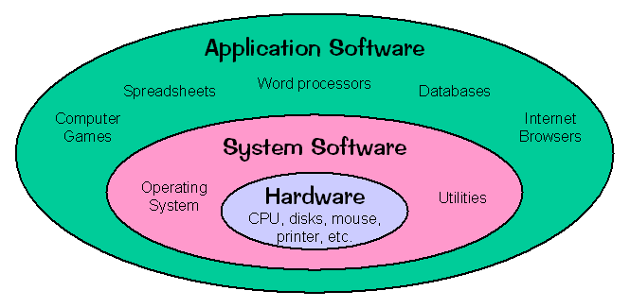
Relationship between System and Application Software
01
08
Middle Level
Language
02
Memory
Management
Structured
Language
Speed
03
07
Rich Library
04
Pointers
Extensible
Recursion
05
Fig: Block Diagram for Relationship between System and Application Software
PROGRAMMING FOR PROBLEM SOLVING
UNIT-I
Department of CSE, School of Engineering, Malla Reddy University, Hyderabad.

Slide 13
COMPUTING ENVIRONMENTS
The Computers are mostly used in the following Computing environments.
Personal Computing Environment
Time Sharing Environment
Client/Server Environment
Distributed Computing
Environment
PROGRAMMING FOR PROBLEM SOLVING
UNIT-I
Department of CSE, School of Engineering, Malla Reddy University, Hyderabad.

Slide 14
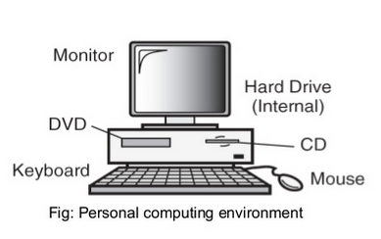
Personal Computing Environment
Personal Computing Environment
Personal Computing Environment
This kind of computing is used to satisfy the needs of a single user, who uses the computer for the personal tasks.
Time Sharing Environment
Client/Server Environment
Distributed Computing
Environment
PROGRAMMING FOR PROBLEM SOLVING
UNIT-I
Department of CSE, School of Engineering, Malla Reddy University, Hyderabad.

Slide 15
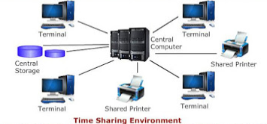
Time Sharing Environment
Time Sharing Environment
Personal Computing Environment
The concept of time-sharing computing is to share the processing of the computer basing on the criteria time. In this environment all the computing must be done by the central computer
Time Sharing Environment
Client/Server Environment
Distributed Computing
Environment
PROGRAMMING FOR PROBLEM SOLVING
UNIT-I
Department of CSE, School of Engineering, Malla Reddy University, Hyderabad.

Slide 16
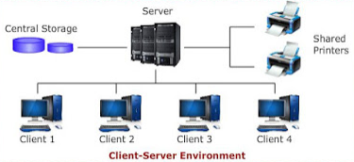
Client/Server Environment
Client/Server Environment
Personal Computing Environment
A Client/Server Computing involves the processing between two machines. A client Machine is the one which requests processing. Server Machine is the one which offers the processing.
Time Sharing Environment
Client/Server Environment
Distributed Computing
Environment
PROGRAMMING FOR PROBLEM SOLVING
UNIT-I
Department of CSE, School of Engineering, Malla Reddy University, Hyderabad.

Slide 17
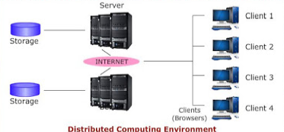
Distributed Computing Environment
Personal Computing Environment
Sample Text
In this, The computing complexity will be distributed among multiple servers and clients, which are having connectivity. This environment is reliable and scalable.
Time Sharing Environment
Client/Server Environment
Distributed Computing
Environment
PROGRAMMING FOR PROBLEM SOLVING
UNIT-I
Department of CSE, School of Engineering, Malla Reddy University, Hyderabad.

Slide 18
COMPUTER LANGUAGES
To write a program (tells what to do) for a computer, we must use a computer language. Generally humans are communicating to the computer with the help of programming languages, these languages are mainly divided into two types such as
programming languages
01
08
Middle Level
Language
02
Memory
Management
Structured
Language
03
Speed
Low level language
High level language
07
Rich Library
04
Pointers
Extensible
Machine level Language (Binary level language)
Assembly level language (Symbolic language)
Recursion
05
PROGRAMMING FOR PROBLEM SOLVING
UNIT-I
Department of CSE, School of Engineering, Malla Reddy University, Hyderabad.

Slide 19
Machine level Language
Machine level Language
The Machine level language which is made of streams of 0‘s and 1‘s. The instructions in machine language must be in streams of 0‘s and 1‘s.
Advantages:
1. High speed execution
2. The computer can understand the
instructions immediately
3. No translation is needed.
Disadvantages:
1. Machine dependent
2. Programming is very difficult
3. Difficult to understand
4. Difficult to write bug free programs
5. Difficult to isolate an error
Machine level Language
Assembly level language
High level language
PROGRAMMING FOR PROBLEM SOLVING
UNIT-I
Department of CSE, School of Engineering, Malla Reddy University, Hyderabad.

Slide 20
Assembly level language
Assembly level language
Machine level Language
The Assembly level language is made up of mnemonics. But the computer can not understand this language. So we need conversion
Advantages:
1. High speed execution
2. The computer can understand the
instructions
3. translation is needed.
Disadvantages:
1. Machine dependent
2. Programming is very difficult
3. Difficult to understand
4. Difficult to write bug free programs
5. Difficult to isolate an error
Assembly level language
High level language
Assembly level language
Assembler
Machine level Language
PROGRAMMING FOR PROBLEM SOLVING
UNIT-I
Department of CSE, School of Engineering, Malla Reddy University, Hyderabad.

Slide 21
High level language
High level language
Machine level Language
The High level language is similar to natural language like English language. But the computer can not understand this language. So we need conversion
Advantages:
1. Easy to write and understand
2. Easy to isolate an error
3. Machine independent language
4. Easy to maintain
5. Better readability
6. Low Development cost
7. Easier to document
Disadvantages:
1. Needs translator
2. Requires high execution time
3. Poor control on hardware.
Assembly level language
High level language
High level language
Compiler (or)
Interpreter
Machine level Language
PROGRAMMING FOR PROBLEM SOLVING
UNIT-I
Department of CSE, School of Engineering, Malla Reddy University, Hyderabad.

Slide 22
High level language
Differences between Machine, Assembly, and High Level Languages
Feature | Machine | Assembly | High Level
Form of instructions | 0‘s and 1‘s | Mnemonic codes | Normal English
Machine Dependent | Dependent | Dependent | Independent
Translator | Not Needed | Needed (Assembler) | Needed (Compiler)
Execution Time | Less | Less | High
Languages | Only one | Different Manufacturers | Different Languages
Nature | Difficult | Difficult | Easy
Memory Space | Less | Less | More
01
08
Middle Level
Language
02
Memory
Management
Structured
Language
Speed
03
07
Rich Library
04
Pointers
Extensible
Recursion
05
PROGRAMMING FOR PROBLEM SOLVING
UNIT-I
Department of CSE, School of Engineering, Malla Reddy University, Hyderabad.

Slide 23
Algorithm is a step by step procedure for solving a particular problem. The characteristics of a good algorithms are:
ALGORITHM
The algorithm receives input
Input (Read)
The algorithm produces output
Output (Write)
  Each instruction must be clear, well defined and precise. There should not be any ambiguity
Definiteness
Finiteness
The algorithm should be a sequence of finite instructions.
The operations must be simple and must be completed in a finite time.
Effectiveness
PROGRAMMING FOR PROBLEM SOLVING
UNIT-I
Department of CSE, School of Engineering, Malla Reddy University, Hyderabad.

Slide 24
ALGORITHM
Q. Write an algorithm to find sum of two numbers? Ans.
Step 1: Start
Step 2: [Read A and B]
Read a,b
Step 3: [Compute]
Sum=A+B
Step 4: [Write Sum]
Print Sum
Step 5: [end] Stop.
01
08
Middle Level
Language
02
Memory
Management
Structured
Language
Speed
03
07
Rich Library
04
Pointers
Extensible
Recursion
05
PROGRAMMING FOR PROBLEM SOLVING
UNIT-I
Department of CSE, School of Engineering, Malla Reddy University, Hyderabad.

Slide 25





FLOWCHART
Flowchart is a Symbolic representation of an algorithm.
Flowchart is very helpful in writing program and explaining program to others.
In flowchart each symbol indicates particular operation. While drawing the flow chart, operation must be written inside the symbols.
Symbol | Symbol Name | Purpose | Description
 | Arrow | Flow line | Used to indicate the flow of logic by connecting symbols.
 | Oval | Terminal (Stop/Start) | Used to represent start and end of flowchart.
 | Parallelogram | Input /Output | Used for input and output operation.
 | Rectangle | Processing | Used for arithmetic operations and data- manipulations.
 | Rhombus | Decision | Used to represent the operation in which there are two alternatives, true and false.
 | Circle | On-page Connector | Used to join different flow line
01
Middle Level
Language
02
Structured
Language
Speed
03
07
Rich Library
04
Pointers
Extensible
Recursion
05
PROGRAMMING FOR PROBLEM SOLVING
UNIT-I
Department of CSE, School of Engineering, Malla Reddy University, Hyderabad.

Slide 26

Aim of Flowcharts
01
Simplicity
Program preparation can be simplified using the flowcharts.
02
Understandability
Flowcharts are easier to understand at a glance, than the narrative description of algorithm.
03
Analysis and Compare
Flowcharts are easy to analyze and compare various methods.
04
Documentation
Flowcharts provide effective programming documentation
Department of CSE, School of Engineering
PROGRAMMING FOR PROBLEM SOLVING
UNIT-I
Department of CSE, School of Engineering, Malla Reddy University, Hyderabad.

Slide 27
Basic Design Structures in Flowcharts
Design Structures in Flowcharts
.
Sequence structure
Loop structure
Selection structure
Top tested loop
Bottom tested loop
PROGRAMMING FOR PROBLEM SOLVING
UNIT-I
Department of CSE, School of Engineering, Malla Reddy University, Hyderabad.
Department of CSE, School of Engineering

Slide 28
Sequence structure
It is more than a series of statements
performed one after another.
It is a sequence because the flow
always continues in same direction
every time the structure is executed.
Start
Read
Process
Output
Stop
PROGRAMMING FOR PROBLEM SOLVING
UNIT-I
Department of CSE, School of Engineering, Malla Reddy University, Hyderabad.
Department of CSE, School of Engineering

Slide 29
Selection Structure
Selection structure uses a decision to ask some question.
This structure includes the decision and the operations to be performed in response to the decision.
There will be two exits from the decision, but both of these branches are still a part of the selection structure, then both branches must rejoin a single flow line to exit the structure.
Is A>B
B is Big
A is Big
Department of CSE, School of Engineering
PROGRAMMING FOR PROBLEM SOLVING
UNIT-I
Department of CSE, School of Engineering, Malla Reddy University, Hyderabad.

Slide 30
Loop Structure
This structure allows you to repeat a task over and over.
The loop structure is used to execute a sequence of steps
in a number of times or until a particular condition is met.
There are two loop structures are available, one is top
tested loop and other is bottom tested loop
Department of CSE, School of Engineering
PROGRAMMING FOR PROBLEM SOLVING
UNIT-I
Department of CSE, School of Engineering, Malla Reddy University, Hyderabad.

Slide 31
Top tested loop
Start
In this the decision is evaluated always at the first statements of the loop.
If it is true, the control follows the flow lines that goes into the loop.
If it is false, control follows the flow line to the first statement after the loop.
count = 0
Is count<10
Stop
Add 1 to count
Display count
PROGRAMMING FOR PROBLEM SOLVING
UNIT-I
Department of CSE, School of Engineering, Malla Reddy University, Hyderabad.
Department of CSE, School of Engineering

Slide 32
Bottom Tested Loop
This loop is a trailing decision loop, means that the decision is always at the last statement of the loop. The body of the loop will be executed once before control even gets to the loop test.
In this loop, if the condition is false, control follows the flow line back to the loop.
If the test is true, control follows the branch from the decision box that exits the loop structure.
Start
count = 0
Add 1 to count
Display count
Iscount >10
Stop
Department of CSE, School of Engineering

Slide 33
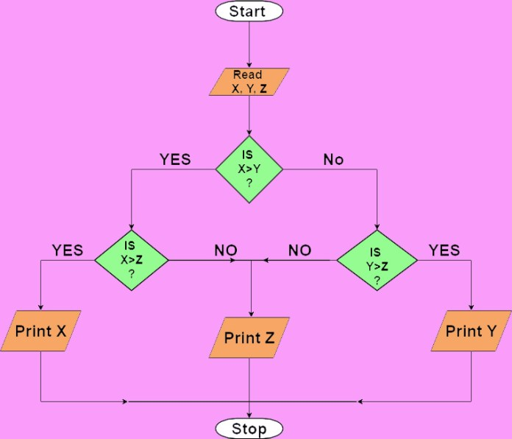
Example:
Draw a flowchart for find out the largest among three different numbers.
01
08
Middle Level
Language
02
Memory
Management
Structured
Language
Speed
03
07
Rich Library
04
Pointers
Extensible
Recursion
05
PROGRAMMING FOR PROBLEM SOLVING
UNIT-I
Department of CSE, School of Engineering, Malla Reddy University, Hyderabad.

Slide 34
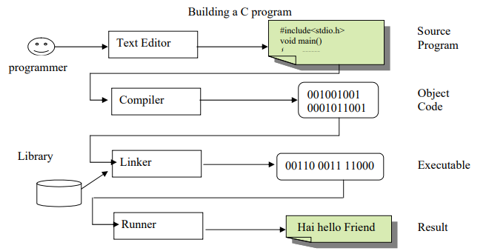
STEPS FOR CREATING AND RUNNING PROGRAMS
01
The four steps are required to create and running a program.
1. Writing the program
2. Compiling the program
3. Linking the program with the
required modules
4. Executing the program
08
Middle Level
Language
02
Memory
Management
Structured
Language
Speed
03
07
Rich Library
04
Pointers
Extensible
Recursion
05
Fig: Steps for Creating and Running Programs
PROGRAMMING FOR PROBLEM SOLVING
UNIT-I
Department of CSE, School of Engineering, Malla Reddy University, Hyderabad.

Slide 35
INTRODUCTION TO ‘C’ LANGUAGE
‘C’ is a high-level programming language that was originally developed by Dennis Ritchie in 1972 at bell laboratories of AT&T (American Telephone & Telegraph), located in the U.S.A.
Initially, ‘C’ language was developed to be used in UNIX operating system. It inherits many features of previous languages such as ALGOL60, BCPL and B.
‘C’ language overcome the problems of previous languages means that they are not support the modern technologies. But the usage of computer programmers are very high on that time. So that ‘C’ is invented.
01
08
Middle Level
Language
02
Memory
Management
Structured
Language
Speed
03
07
Rich Library
04
Pointers
Extensible
Recursion
05
PROGRAMMING FOR PROBLEM SOLVING
UNIT-I
Department of CSE, School of Engineering, Malla Reddy University, Hyderabad.

Slide 36
C Programming language
Language
The way of communication between two persons
EX: Hindi,English,Kannada,Panjabi,Matati,Sign language, Etc
Programming language
The way of communication between a man and machine
Instruction/commands
Program(set of instruction)
Language(written in some language)
Programming Language(language is called Programming language)
01
08
Middle Level
Language
02
Memory
Management
Structured
Language
Speed
03
07
Rich Library
04
Pointers
Extensible
Recursion
05
PROGRAMMING FOR PROBLEM SOLVING
UNIT-I
Department of CSE, School of Engineering, Malla Reddy University, Hyderabad.

Slide 37
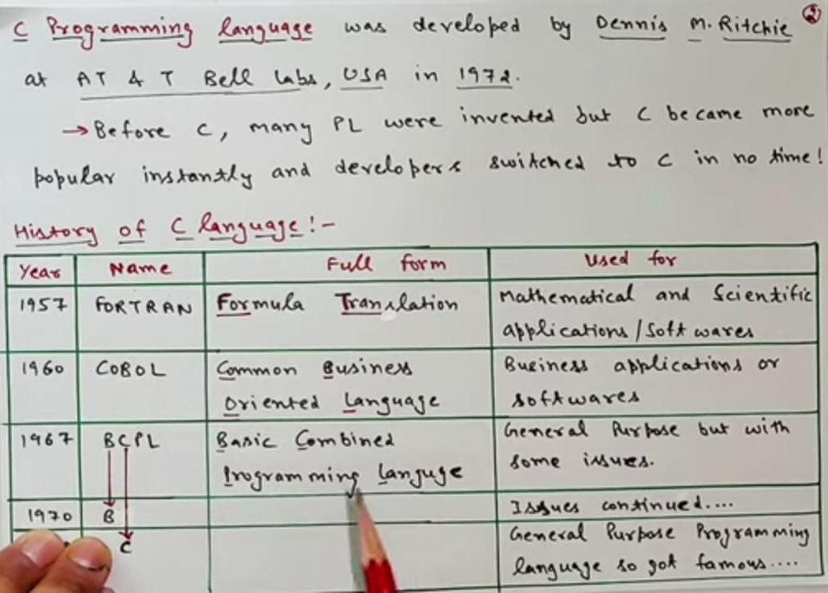
C Programming language
01
08
Middle Level
Language
02
Memory
Management
Structured
Language
Speed
03
07
Rich Library
04
Pointers
Extensible
Recursion
05
PROGRAMMING FOR PROBLEM SOLVING
UNIT-I
Department of CSE, School of Engineering, Malla Reddy University, Hyderabad.

Slide 38
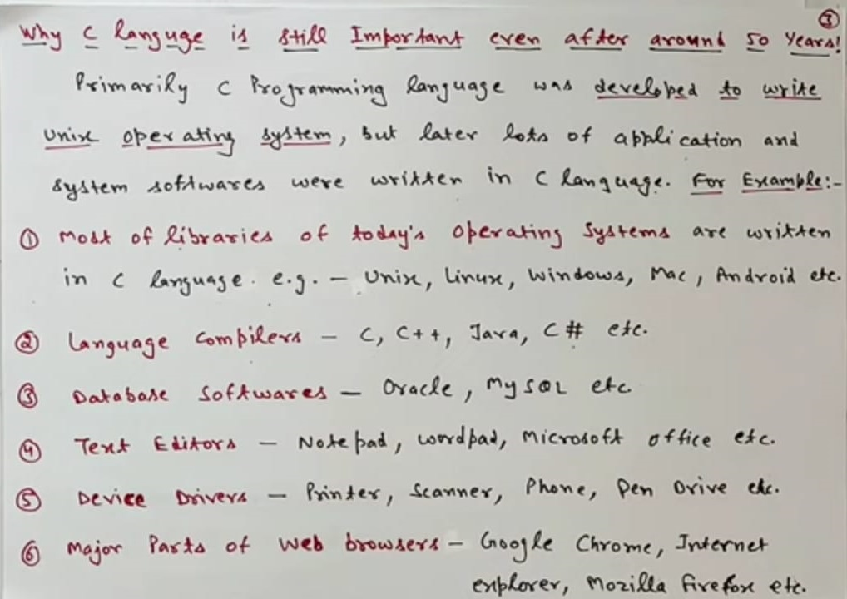
C Programming language
01
08
Middle Level
Language
02
Memory
Management
Structured
Language
Speed
03
07
Rich Library
04
Pointers
Extensible
Recursion
05
PROGRAMMING FOR PROBLEM SOLVING
UNIT-I
Department of CSE, School of Engineering, Malla Reddy University, Hyderabad.

Slide 39
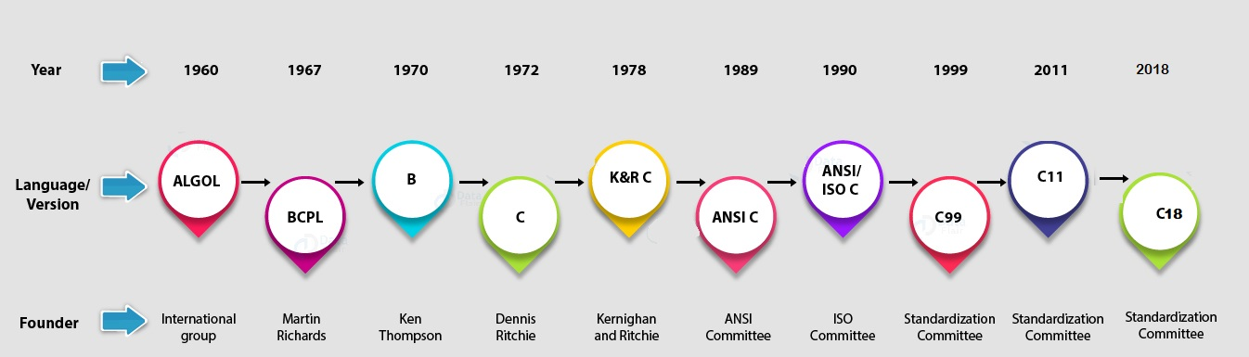
HISTORY OF C LANGUAGE
The C programming language came out from Bell Labs in the early 1972 and ‘C’ standard was ratified as “ANSI C” in 1989 by ANSI Committee (American National Standard Institute). Currently, we are on the fourth standard of C, known as C18 as it was published in June of 2018.
01
08
Middle Level
Language
02
Memory
Management
Structured
Language
Speed
03
07
Rich Library
04
Pointers
Extensible
Recursion
05
PROGRAMMING FOR PROBLEM SOLVING
UNIT-I
Department of CSE, School of Engineering, Malla Reddy University, Hyderabad.

Slide 40

Features of C Language
01
08
Middle Level
Language
02
Memory
Management
Structured
Language
03
Speed
07
Rich Library
04
Pointers
Extensible
06
Recursion
05
Dr E.V.Reddy
UNIT-I
Department of CSE, School of Engineering, Malla Reddy University, Hyderabad.
PROGRAMMING FOR PROBLEM SOLVING
Department of CSE, School of Engineering

Slide 41
Features of C Language
01
01
08
Middle Level
Language
02
Middle Level Language
Memory
Management
Structured
Language
As a middle-level language, C combines the features of both high-level and low-level languages.
It can be used for low-level programming, such as scripting for drivers and kernels.
It also supports functions of high-level programming languages, such as scripting for software applications etc.
Speed
03
Rich Library
07
Pointers
Extensible
04
06
Recursion
05
Dr E.V.Reddy
UNIT-I
Department of CSE, School of Engineering, Malla Reddy University, Hyderabad.
PROGRAMMING FOR PROBLEM SOLVING
Department of CSE, School of Engineering

Slide 42
Features of C Language
01
02
08
Middle Level
Language
02
Structured Language
Memory
Management
Structured
Language
‘C’ is a structured programming language in the sense that we can break the program into parts using functions. So, it is easy to understand and modify. Functions also provide code reusability.
Speed
03
07
Rich Library
Pointers
Extensible
04
06
Recursion
05
Dr E.V.Reddy
UNIT-I
Department of CSE, School of Engineering, Malla Reddy University, Hyderabad.
PROGRAMMING FOR PROBLEM SOLVING
Department of CSE, School of Engineering

Slide 43
Features of C Language
01
03
08
Middle Level
Language
02
Rich Library
Memory
Management
Structured
Language
‘C’ language has a rich library which provides a number of built-in functions.
Speed
03
07
Rich Library
Pointers
Extensible
04
06
Recursion
05
Dr E.V.Reddy
UNIT-I
Department of CSE, School of Engineering, Malla Reddy University, Hyderabad.
PROGRAMMING FOR PROBLEM SOLVING
Department of CSE, School of Engineering

Slide 44
Features of C Language
01
04
08
02
Extensible
Middle Level
Language
Memory
Management
Structured
Language
‘C’ language is extensible because it can easily adopt new features.
Speed
03
07
Rich Library
Pointers
Extensible
04
06
Recursion
05
Dr E.V.Reddy
UNIT-I
Department of CSE, School of Engineering, Malla Reddy University, Hyderabad.
PROGRAMMING FOR PROBLEM SOLVING
Department of CSE, School of Engineering

Slide 45
Features of C Language
01
05
08
Middle Level
Language
02
Recursion
Memory
Management
Structured
Language
In C, we can call the function within the function. It provides code reusability for every function. Recursion enables us to use the approach of backtracking.
Speed
03
07
Rich Library
Pointers
Extensible
04
06
Recursion
05
Dr E.V.Reddy
UNIT-I
Department of CSE, School of Engineering, Malla Reddy University, Hyderabad.
PROGRAMMING FOR PROBLEM SOLVING
Department of CSE, School of Engineering

Slide 46
Features of C Language
01
06
08
Middle Level
Language
02
Pointers
Memory
Management
Structured
Language
We can directly interact with the memory by using the pointers.
We can use pointers for memory, structures, functions, array, etc.
Speed
03
07
Rich Library
Pointers
Extensible
04
06
Recursion
05
Dr E.V.Reddy
UNIT-I
Department of CSE, School of Engineering, Malla Reddy University, Hyderabad.
PROGRAMMING FOR PROBLEM SOLVING
Department of CSE, School of Engineering

Slide 47
Features of C Language
01
07
08
02
Speed
Middle Level
Language
Memory
Management
Structured
Language
The compilation and execution time of C language is fast since there are lesser inbuilt functions and hence the lesser overhead.
Speed
03
07
Rich Library
Pointers
Extensible
04
06
Recursion
05
Dr E.V.Reddy
UNIT-I
Department of CSE, School of Engineering, Malla Reddy University, Hyderabad.
PROGRAMMING FOR PROBLEM SOLVING
Department of CSE, School of Engineering

Slide 48
Features of C Language
01
08
08
Middle Level
Language
02
Memory Management
Memory
Management
Structured
Language
It supports the feature of dynamic memory allocation.
In C language, we can free the allocated memory at any time by calling the free() function.
Speed
03
07
Rich Library
Pointers
Extensible
04
06
Recursion
05
Dr E.V.Reddy
UNIT-I
Department of CSE, School of Engineering, Malla Reddy University, Hyderabad.
PROGRAMMING FOR PROBLEM SOLVING
Department of CSE, School of Engineering

Slide 49
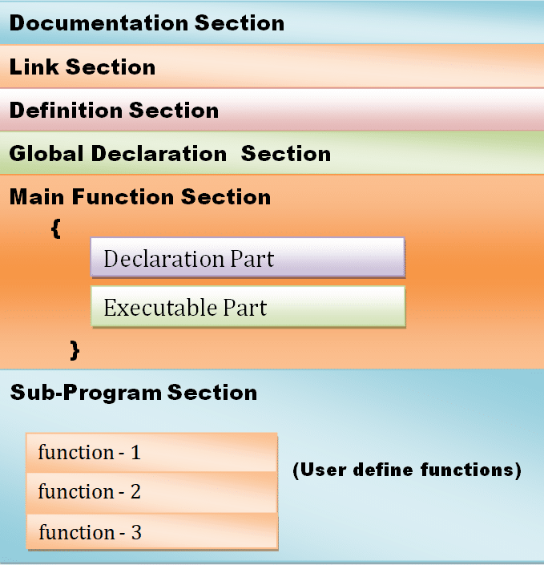
BASIC STRUCTURE OF C PROGRAM
01
08
Middle Level
Language
02
Memory
Management
Structured
Language
Speed
03
07
Rich Library
04
Pointers
Extensible
Recursion
05
PROGRAMMING FOR PROBLEM SOLVING
UNIT-I
Department of CSE, School of Engineering, Malla Reddy University, Hyderabad.

Slide 50
BASIC STRUCTURE OF ‘C’ PROGRAM
The documentation section consists of a set of comment lines giving the name of the program. This section is not part of the program. But it helpful to the programmers.
This section contains single line comments
(or) Multiple line comments
Syntax for Single line:
// addition of two integer numbers
Syntax for multiple lines:
/* addition of
two integer
numbers */
01
Documentation Section
PROGRAMMING FOR PROBLEM SOLVING
UNIT-I
Department of CSE, School of Engineering, Malla Reddy University, Hyderabad.

Slide 51
BASIC STRUCTURE OF C PROGRAM
The link section provides instructions to the compiler to link functions from the system library . At present system library contains 25 header files, each one is used for some special purpose.
Syntax: # include <Directive_name.h>
Example: # include<stdio.h>
# include<math.h>
# include<string.h>
02
Link section (or)
Header file Section
PROGRAMMING FOR PROBLEM SOLVING
UNIT-I
Department of CSE, School of Engineering, Malla Reddy University, Hyderabad.

Slide 52
BASIC STRUCTURE OF C PROGRAM
The definition section defines all symbolic constants means that the predefined string (or) token of a ‘C’ software is replaced with identifier by using # define directives. This section is also called as ‘macro’ section.
Syntax: # define identifier string(or) token
Ex: # define p printf
/* printf(“ welcome”);
(or)
P(“welcome”); */
03
Definition section
PROGRAMMING FOR PROBLEM SOLVING
UNIT-I
Department of CSE, School of Engineering, Malla Reddy University, Hyderabad.

Slide 53
BASIC STRUCTURE OF C PROGRAM
This section consists of global variables means that the variables and user-defined functions. are declared out side of the main () function. The variables scope is entire program and its has constant value through out the program.
These variables are also called as ‘External
variables’.
Ex: int a=10;
void display();
main()
{
------
-------
}
04
Global declaration section
PROGRAMMING FOR PROBLEM SOLVING
UNIT-I
Department of CSE, School of Engineering, Malla Reddy University, Hyderabad.

Slide 54
BASIC STRUCTURE OF C PROGRAM
main () function section: Every C program execution is first starts from main () function section. This section contains two parts.
1. Declaration part
2. Executable part.
. These two parts must appear between the opening and closing curve braces. The declaration part declares all the variables used in the executable part and executable part contains at least one statement.
05
main () function section
PROGRAMMING FOR PROBLEM SOLVING
UNIT-I
Department of CSE, School of Engineering, Malla Reddy University, Hyderabad.

Slide 55
BASIC STRUCTURE OF C PROGRAM
If the program is a multi-function program then the subprogram section contains all the user-defined called functions. These User-defined functions are generally placed immediately after the main () function, although they may appear in any order.
06
Subprogram section
PROGRAMMING FOR PROBLEM SOLVING
UNIT-I
Department of CSE, School of Engineering, Malla Reddy University, Hyderabad.

Slide 56
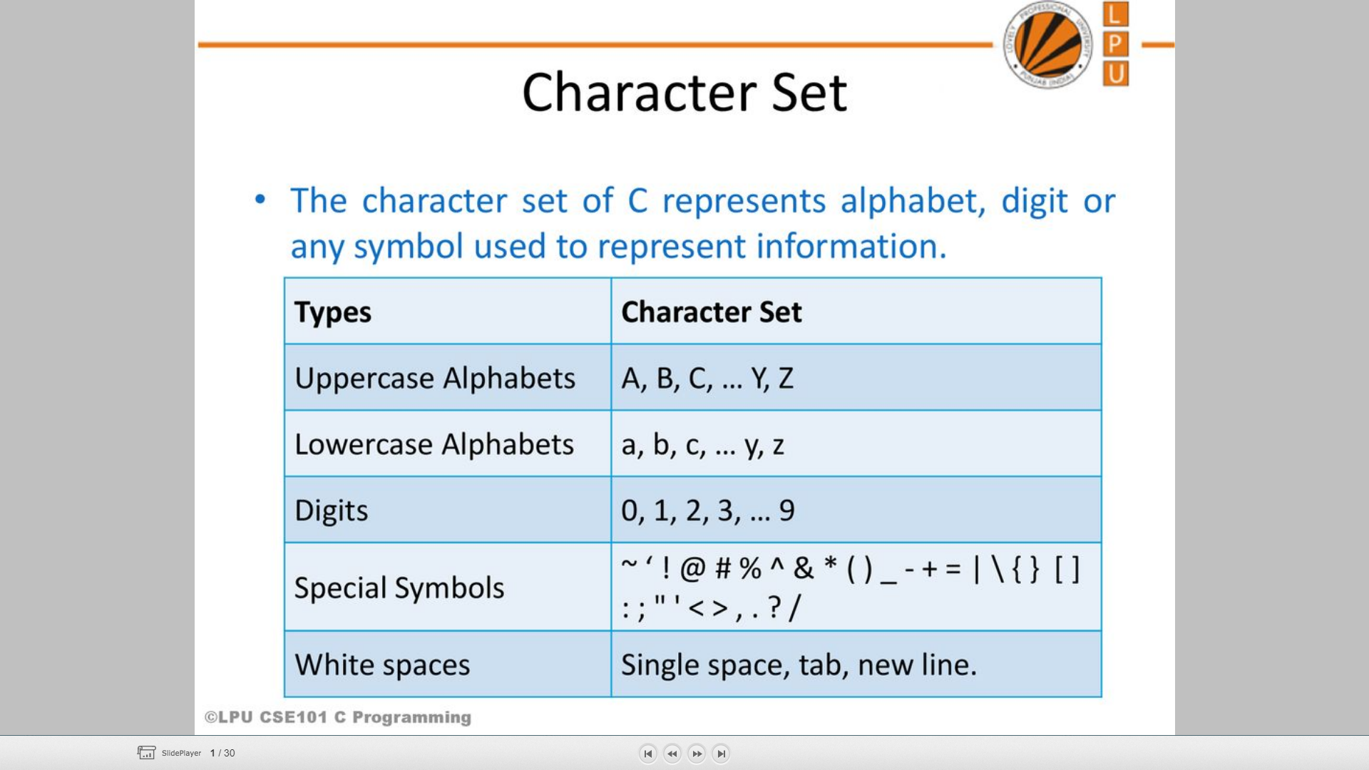
‘C’ CHARACTER SET
01
08
Middle Level
Language
02
Memory
Management
Structured
Language
Speed
03
07
Rich Library
04
Pointers
Extensible
Recursion
05
PROGRAMMING FOR PROBLEM SOLVING
UNIT-I
Department of CSE, School of Engineering, Malla Reddy University, Hyderabad.

Slide 57
‘C’ TOKENS
01
Operators
Keywords
06
02
Identifiers.
Special symbols
05
Strings
Constants
03
04
PROGRAMMING FOR PROBLEM SOLVING
UNIT-I
Department of CSE, School of Engineering, Malla Reddy University, Hyderabad.

Slide 58
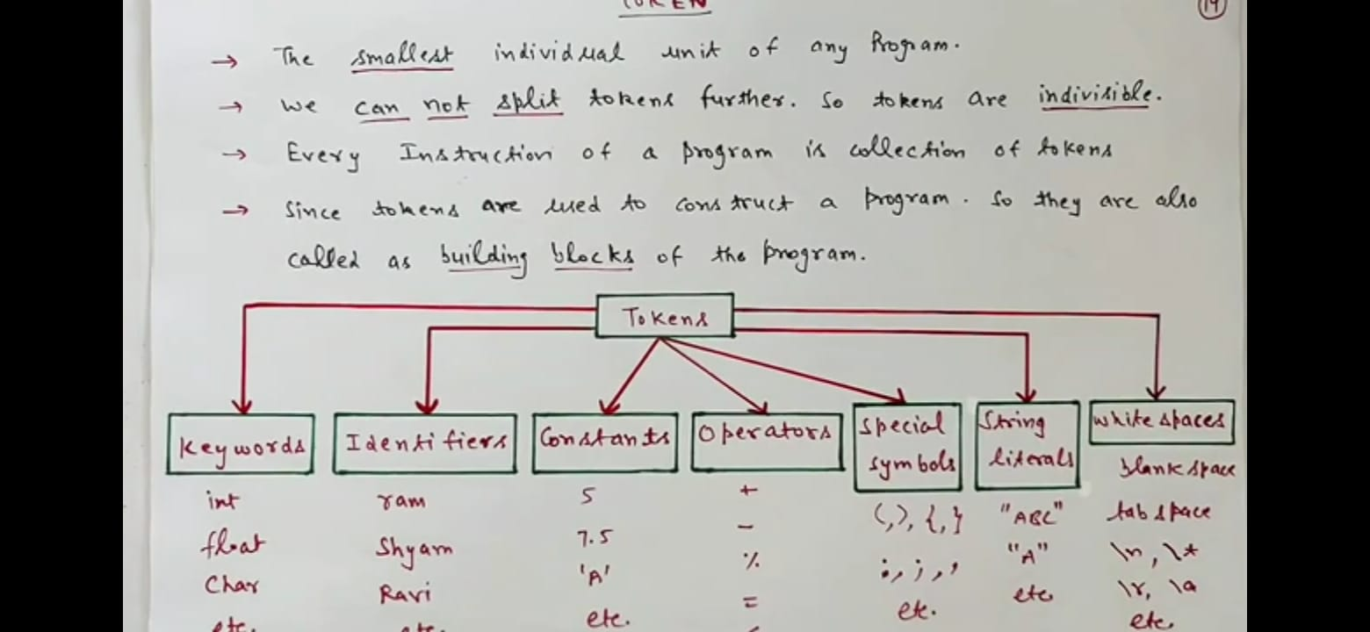
‘C’ TOKENS
PROGRAMMING FOR PROBLEM SOLVING
UNIT-I
Department of CSE, School of Engineering, Malla Reddy University, Hyderabad.

Slide 59
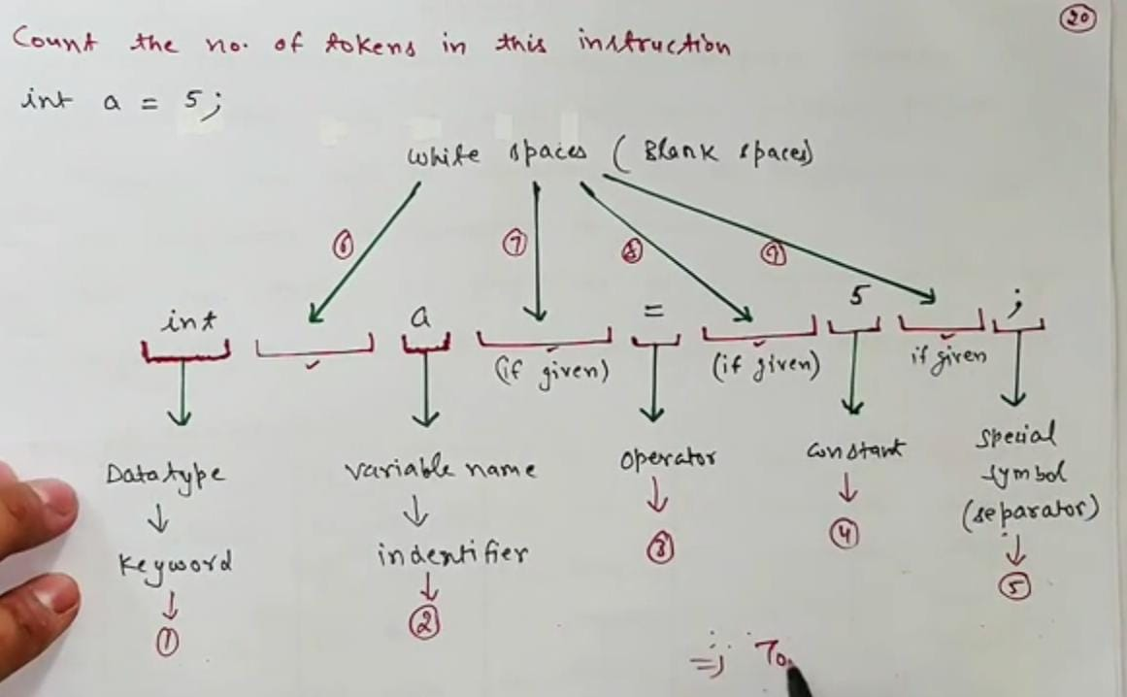
‘C’ TOKENS
PROGRAMMING FOR PROBLEM SOLVING
UNIT-I
Department of CSE, School of Engineering, Malla Reddy University, Hyderabad.

Slide 60
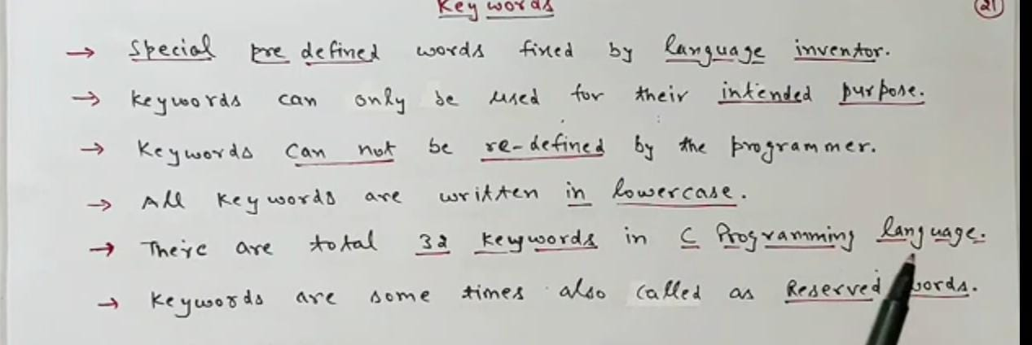
‘C’ TOKENS
01
Keywords
Operators
06
02
Identifiers.
Special symbols
C keywords are the words that convey a special meaning to the c compiler. The keywords cannot be used as variable names.
All keywords should be written in small case only and keywords cannot be used for any other purpose
05
03
Strings
Constants
04
PROGRAMMING FOR PROBLEM SOLVING
UNIT-I
Department of CSE, School of Engineering, Malla Reddy University, Hyderabad.

Slide 61
‘C’ TOKENS
The list of C keywords is given below
01
Keywords
auto | break | case | char | const
continue | default | do | double | else
enum | extern | float | for | goto
if | int | long | register | return
short | signed | sizeof | static | struct
switch | typedef | union | unsigned | void
volatile | while
Operators
06
02
Identifiers.
Special symbols
05
03
Strings
Constants
04
PROGRAMMING FOR PROBLEM SOLVING
UNIT-I
Department of CSE, School of Engineering, Malla Reddy University, Hyderabad.

Slide 62
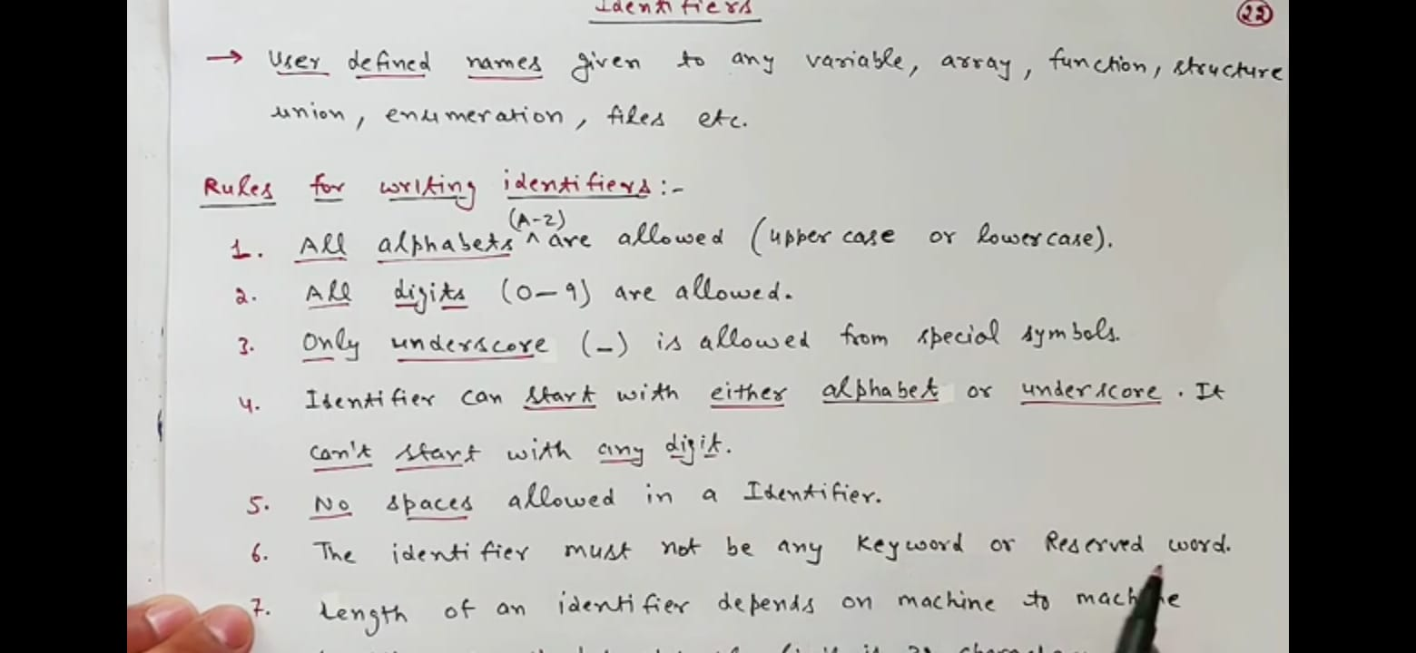
‘C’ TOKENS
01
Keywords
Operators
06
02
"Identifiers" or "symbols" are the names you supply for variables. Rules of creating identifiers:
• The identifier must start with an alphabet or
underscore only
• The name of the identifier can include
alphabets, numbers and special characters
• Only first 31 characters are significant in an
identifier.
• Keywords cannot be used as identifiers
• It must not contain white spaces.
Identifiers.
Special symbols
05
03
Constants
Strings
04
PROGRAMMING FOR PROBLEM SOLVING
UNIT-I
Department of CSE, School of Engineering, Malla Reddy University, Hyderabad.

Slide 63
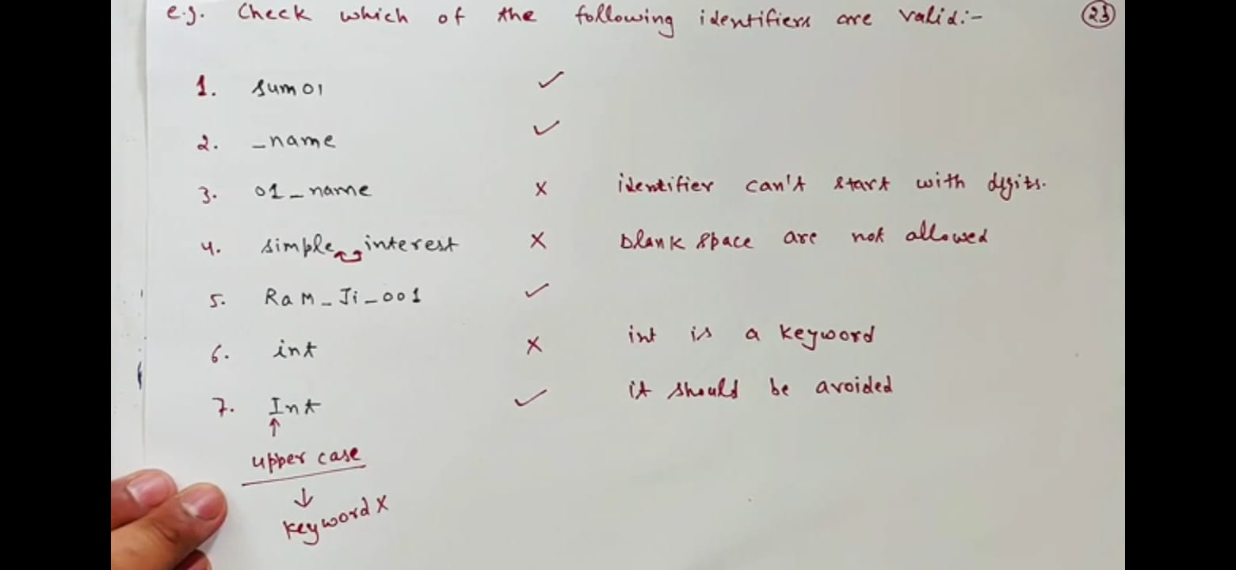
‘C’ TOKENS(Identifiers)
PROGRAMMING FOR PROBLEM SOLVING
UNIT-I
Department of CSE, School of Engineering, Malla Reddy University, Hyderabad.

Slide 64
‘C’ TOKENS
01
Keywords
Operators
06
02
Identifiers.
A C constant refers to the data items that do not change their value during the program execution. Several types of C constants that are allowed in C are:
Integer Constants
Real Constants
Character Constants
String Constants
Special symbols
05
03
Strings
Constants
04
PROGRAMMING FOR PROBLEM SOLVING
UNIT-I
Department of CSE, School of Engineering, Malla Reddy University, Hyderabad.

Slide 65
Integer Constants
Integer constants are whole numbers without any fractional part. It must have at least one digit and may contain
either + or – sign. A number with no sign is assumed to be positive.
There are three types of integer constants:
1. Decimal Integer Constants
This Integer constants consisting of a set of digits, 0 through 9. Example of valid decimal integer constants are
341, -341, 0, 8972
Some examples for invalid integer constants are
15 750 // white space between number
20,000 // comma between number
Rs. 1000 // Characters before number
2. Octal Integer Constants
This Integer constants consisting of sequence of digits from the set 0 through 7 starting with O is said to be
octal integer constants. Example of valid octal integer constants
O26
O
O347
O676
3. Hexadecimal Integer Constants
This integer constants are integer constants having sequence of digits preceded by 0x or 0X. They may also
include alphabets from A to F representing numbers 10 to 15. Example of valid hexadecimal integer constants
0xD, 0X8d, 0X, 0xbD // octal and hexadecimal integer constants are rarely used in programming.
PROGRAMMING FOR PROBLEM SOLVING
UNIT-I
Department of CSE, School of Engineering, Malla Reddy University, Hyderabad.

Slide 66
Real Constants
The numbers having fractional parts are called real or floating-point constants. These may be represented in one of the two forms called fractional form or the exponent form and may also have either + or – sign preceding it.
Example of valid real constants in fractional form or decimal notations are
0.05, -0.905, 562.05, 0.015
Representing a real constant in exponent form
The general format in which a real number may be represented in exponential or scientific form is
Mantissa e exponent
The mantissa must be either an integer or a real number expressed in decimal notation. The letter e separating the mantissa and the exponent. The exponent can also be written in uppercase i.e. E And the exponent must be an integer.
Examples of valid real constants in exponent form are:
252E85, 0.15E-10,-3e+8
PROGRAMMING FOR PROBLEM SOLVING
UNIT-I
Department of CSE, School of Engineering, Malla Reddy University, Hyderabad.

Slide 67
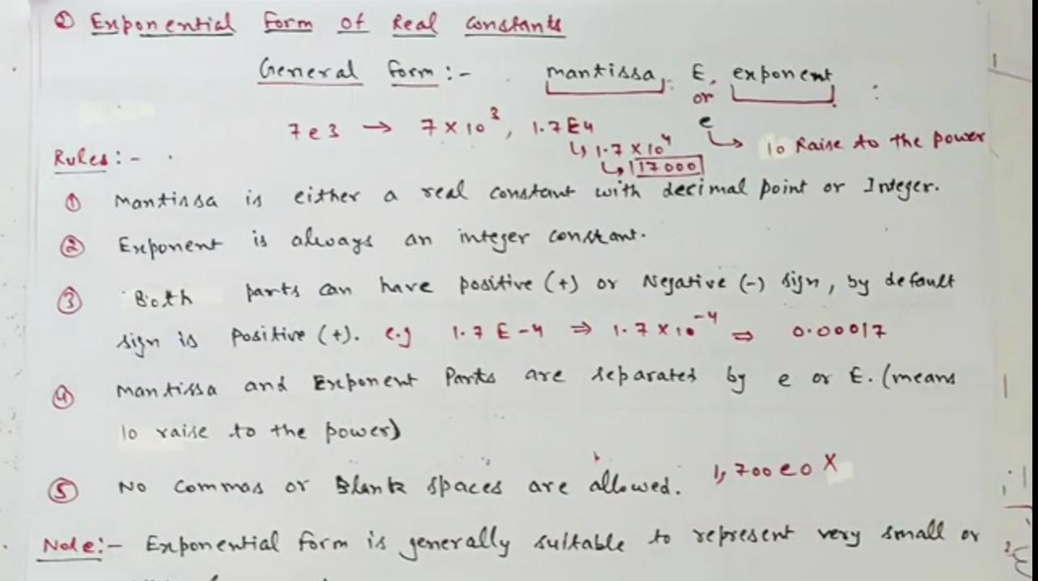
Real Constants
PROGRAMMING FOR PROBLEM SOLVING
UNIT-I
Department of CSE, School of Engineering, Malla Reddy University, Hyderabad.

Slide 68
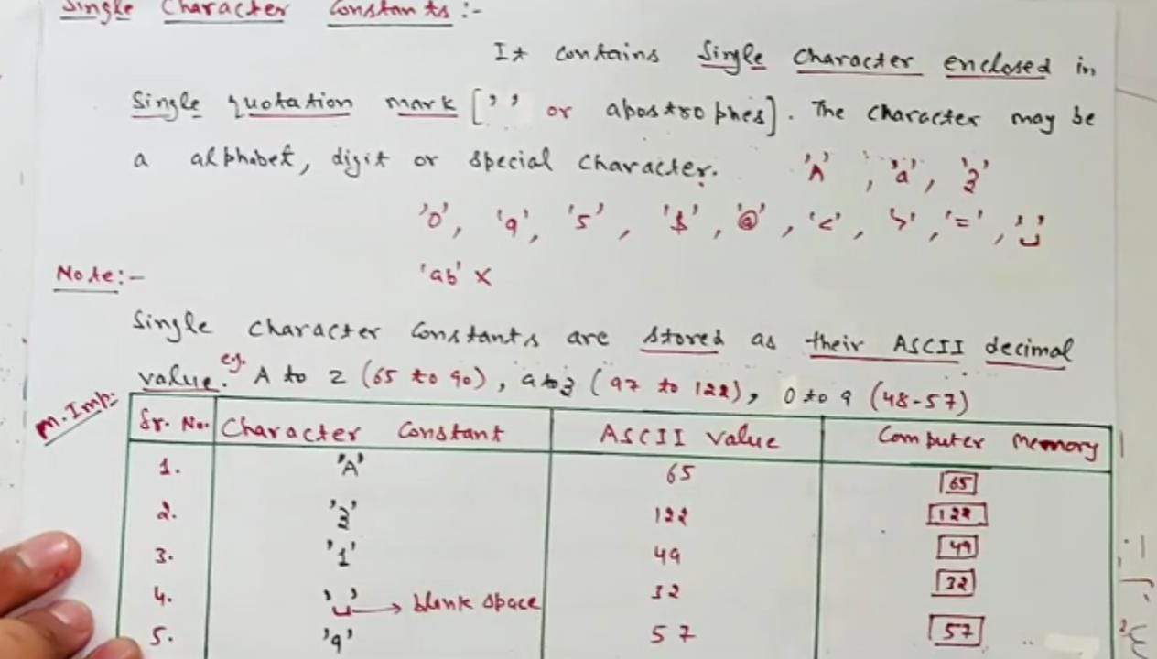
Real Constants
PROGRAMMING FOR PROBLEM SOLVING
UNIT-I
Department of CSE, School of Engineering, Malla Reddy University, Hyderabad.

Slide 69
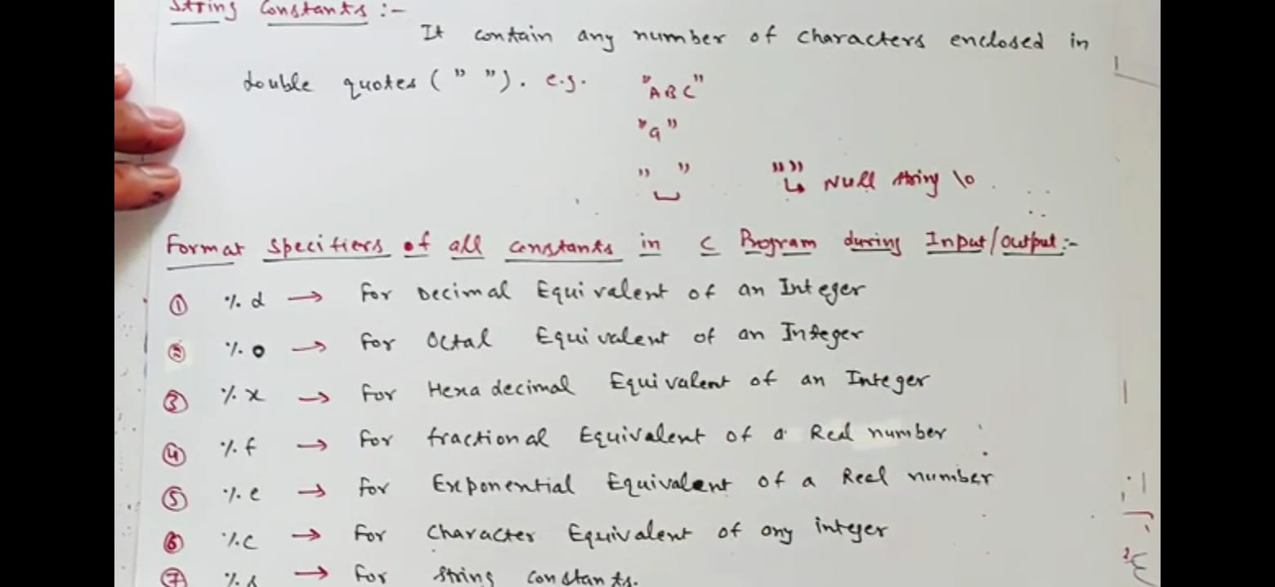
Real Constants
PROGRAMMING FOR PROBLEM SOLVING
UNIT-I
Department of CSE, School of Engineering, Malla Reddy University, Hyderabad.

Slide 70
Character and String Constants
A character constant contains one single character enclosed within single quotes. Where as string constants are enclosed within double quotes.
Examples of character constants are
‘a‘ , ‘Z‘,’5‘.
Examples of character constants are
“a”, ”A”, ”ramu” etc
It should be noted that character constants have numerical values known as ASCII values, for example, the value of ‘A’ is 65 which is its ASCII value.
S.NO | Escape Character constant | Description
1 | \n | New line
2 | \t | Tab Space
3 | \b | One backspace
4 | \r | Carriage return
5 | \a | Beep sound
6 | \” | Double quotation
7 | \\ | Back slash
8 | \0 | Null character
PROGRAMMING FOR PROBLEM SOLVING
UNIT-I
Department of CSE, School of Engineering, Malla Reddy University, Hyderabad.

Slide 71
‘C’ TOKENS
01
Keywords
Operators
06
02
Identifiers.
Special symbols
A string is a sequence of characters enclosed within double quotes Examples of strings are
“ramu”
“raju”
“A”
”ram125”
05
03
Strings
Constants
04
PROGRAMMING FOR PROBLEM SOLVING
UNIT-I
Department of CSE, School of Engineering, Malla Reddy University, Hyderabad.

Slide 72

‘C’ TOKENS
01
Keywords
Operators
06
02
Identifiers.
Special symbols
05
03
Strings
Constants
04
PROGRAMMING FOR PROBLEM SOLVING
UNIT-I
Department of CSE, School of Engineering, Malla Reddy University, Hyderabad.

Slide 73
‘C’ TOKENS
01
Keywords
Operators
06
02
An operator is a symbol that tells the compiler to perform specific mathematical or logical functions. Ex:
Arithmetic Operators
Relational Operators
Logical Operators
Bitwise Operators
Assignment Operators
Identifiers.
Special symbols
05
03
Strings
Constants
04
PROGRAMMING FOR PROBLEM SOLVING
UNIT-I
Department of CSE, School of Engineering, Malla Reddy University, Hyderabad.

Slide 74
DATA TYPES IN ‘C’
Data Types
Primary Data types
Secondary Data types
01
08
Middle Level
Language
02
Memory
Management
Structured
Language
03
Numeric
Data types
Speed
Non-Numeric
Data types
User-defined
Data types
Derived
Data types
07
Rich Library
char
struct
array
Integer
Data type
Floating
Data type
04
Pointers
union
pointer
Extensible
short int
float
enum
int
double
Recursion
05
long int
long double
PROGRAMMING FOR PROBLEM SOLVING
UNIT-I
Department of CSE, School of Engineering, Malla Reddy University, Hyderabad.

Slide 75
Memory size and Ranges of ‘C’ Primary Data types
Data Types | Memory Size | Formatted code | Range
char | 1 byte | %c | −128 to 127
int | 4 bytes | %d | −32,768 to 32,767
short int | 2 bytes | %h | −32,768 to 32,767
long int | 4 bytes | %ld | -9223372036854775808 to 9223372036854775807
float | 4 bytes | %f | 3.4e-38to 3.4e+38
double | 8 bytes | %lf | 1.7e-308 to 1.7e+308
long double | 16 bytes | %Lf | 3.4E _ 4932 to 1.1E + 4932
01
08
Middle Level
Language
02
Memory
Management
Structured
Language
Speed
03
07
Rich Library
04
Pointers
Extensible
Recursion
05
PROGRAMMING FOR PROBLEM SOLVING
UNIT-I
Department of CSE, School of Engineering, Malla Reddy University, Hyderabad.

Slide 76
VARIABLES IN ‘C’
A Variable is a memory location (Storage area), Which is used to store the value. One variable can store only one value at a time. We can't store more than one values. Generally variables are two types
1. Local variables
2. Global variables
Local variables are declared inside the main() function and Global variables are declared outside the
main() function. The name of a variable can be composed of letters, digits, and the underscore character.
Declaration of a variable
Syntax:
Ex:
01
08
Middle Level
Language
02
Memory
Management
Structured
Language
03
Speed
Initialization of variable in C
Method1:
int a;
a=10;
Method2:
int a=10;
07
Rich Library
space
data_type variable_name;
04
Pointers
Extensible
Recursion
int a;
05
PROGRAMMING FOR PROBLEM SOLVING
UNIT-I
Department of CSE, School of Engineering, Malla Reddy University, Hyderabad.

Slide 77
VARIABLES IN ‘C’
Variables used based on the following Conditions:
1. Variable should be declared before it is used in any operations
2. Variable should be declared with any one of the data type.
3. More than one variables can be declared under the single data type, But each variable
name is separated by a comma.
4. Every variable declaration (or) initialization must be end with a semicolon.
5. White space is not allowed between string.
6. Variable should not begin with a digit
7. Variable must begin with either a letter or an underscore.
8. Uppercase and lowercase letters are distinct because ‘C’ is a case-sensitive language.
9. Variable should not be a keyword.
01
08
Middle Level
Language
02
Memory
Management
Structured
Language
Speed
03
07
Rich Library
04
Pointers
Extensible
Recursion
05
PROGRAMMING FOR PROBLEM SOLVING
UNIT-I
Department of CSE, School of Engineering, Malla Reddy University, Hyderabad.

Slide 78
Example: C-Program for Data types and Variable declaration.
#include <stdio.h>
void main ()
{
int a = 4000; // positive integer data type
float b = 5.2324; // float data type
char c = 'Z'; // char data type
long d = 41657; // long positive integer data type
long e = -21556; // long -ve integer data type
int f = -185; // -ve integer data type
short g = 130; // short +ve integer data type
short h = -130; // short -ve integer data type
double i = 4.1234567890; // double float data type
float j = -3.55; // float data type
printf(“value of a is %d”, a); // using print statement we can print values
}
01
08
Middle Level
Language
02
Memory
Management
Structured
Language
Speed
03
C:\Users\Admin\Desktop
07
Rich Library
04
Pointers
Extensible
Recursion
05
PROGRAMMING FOR PROBLEM SOLVING
UNIT-I
Department of CSE, School of Engineering, Malla Reddy University, Hyderabad.

Slide 79

www.mallareddyuniversity.com
Notes:
You can safely remove this slide. This slide design was provided by SlideModel.com – You can download more templates, shapes and elements for PowerPoint from http://slidemodel.com

